Slide 1

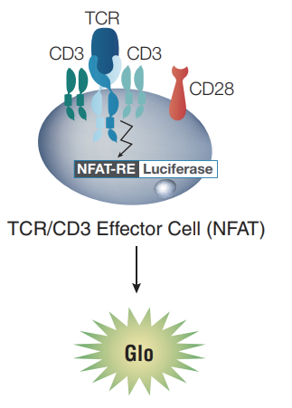
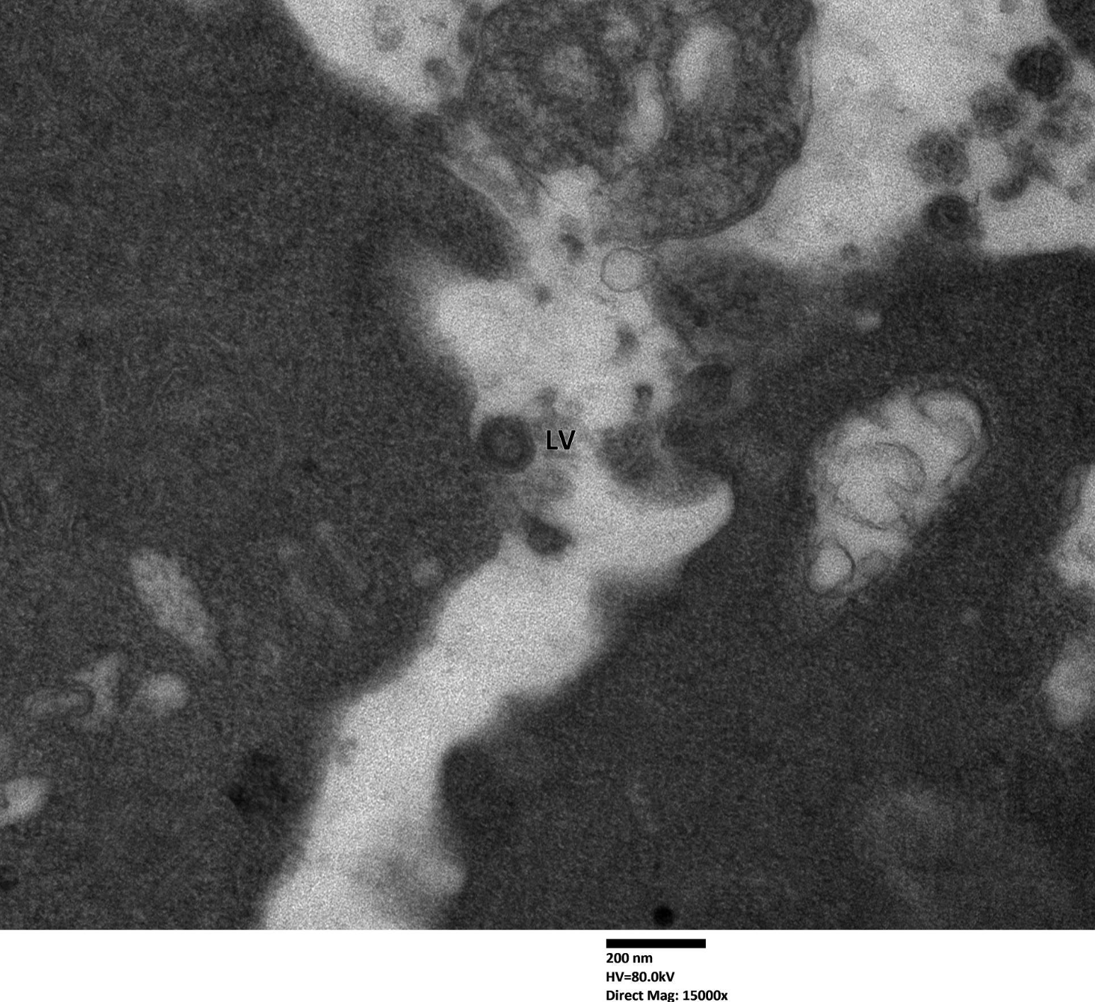
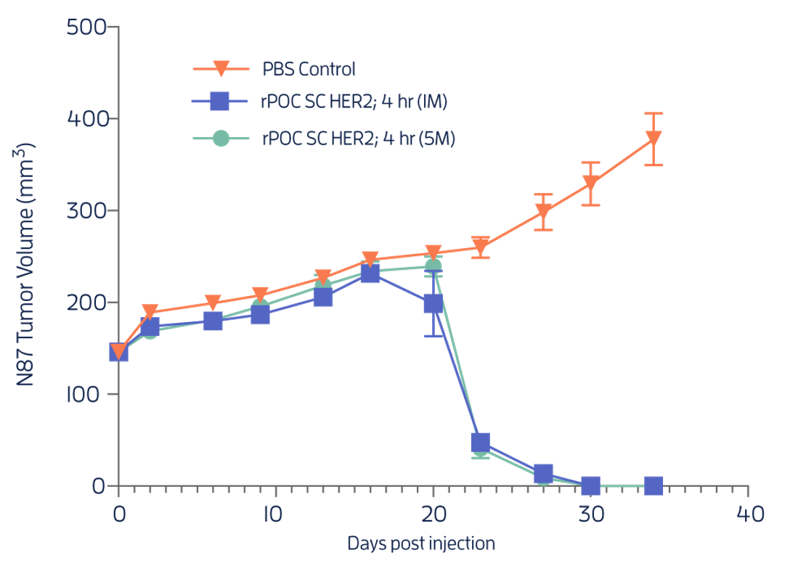
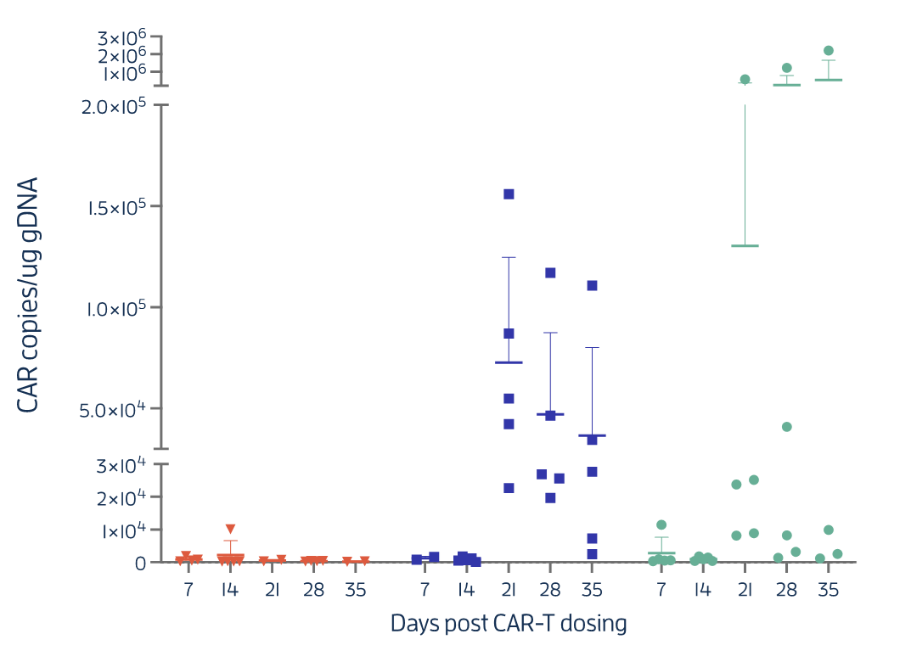
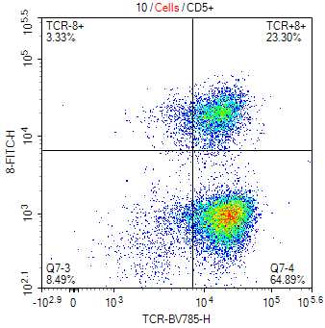
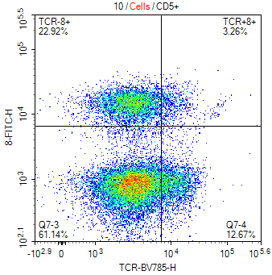
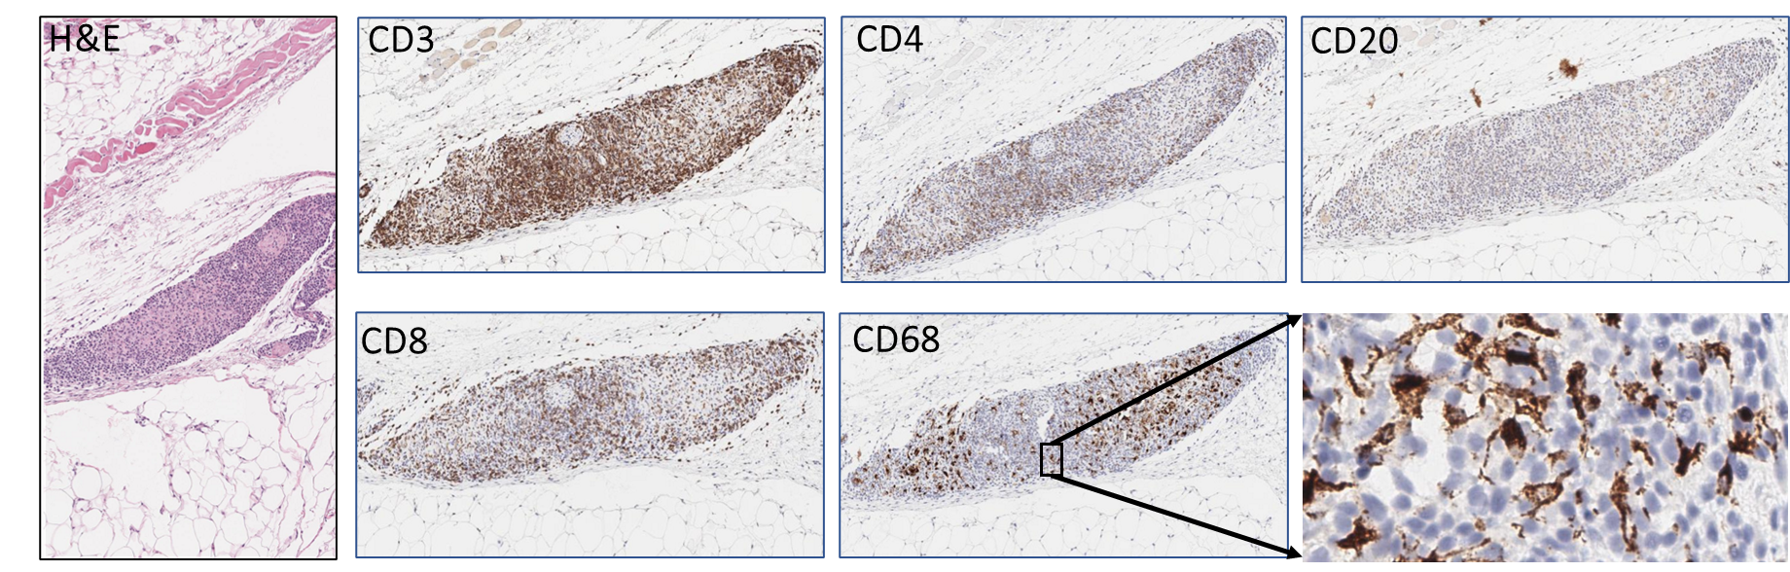
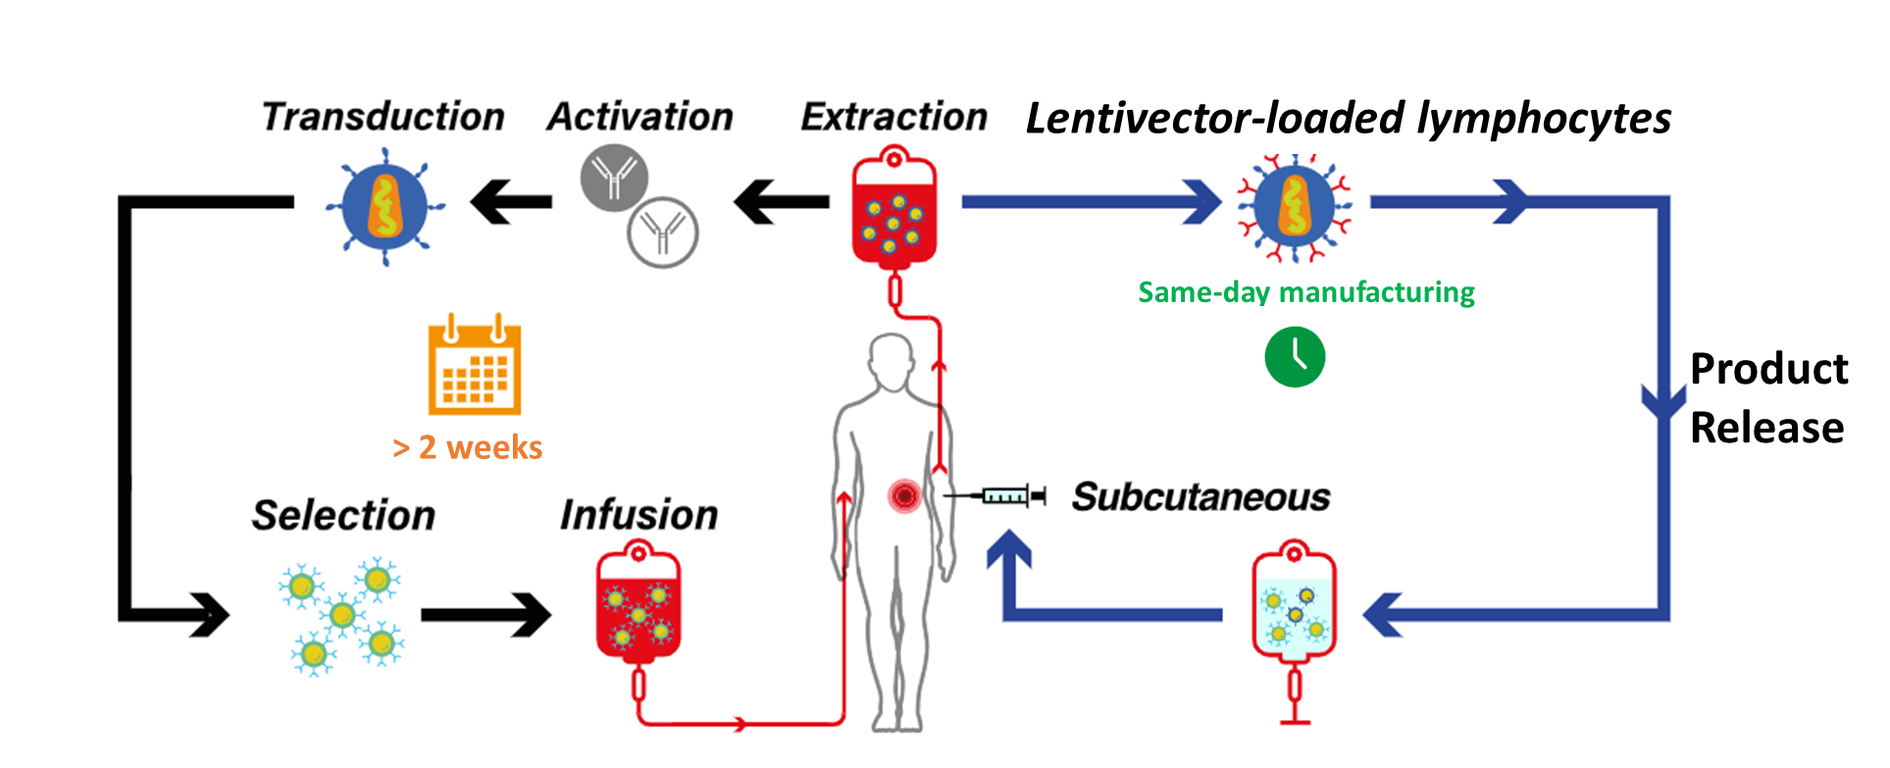
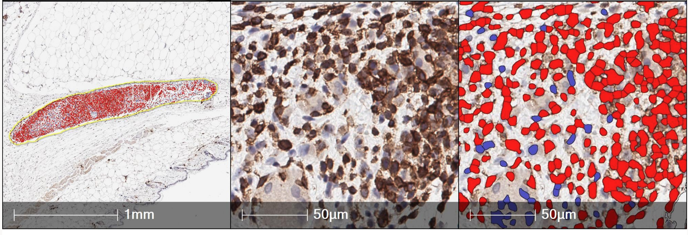
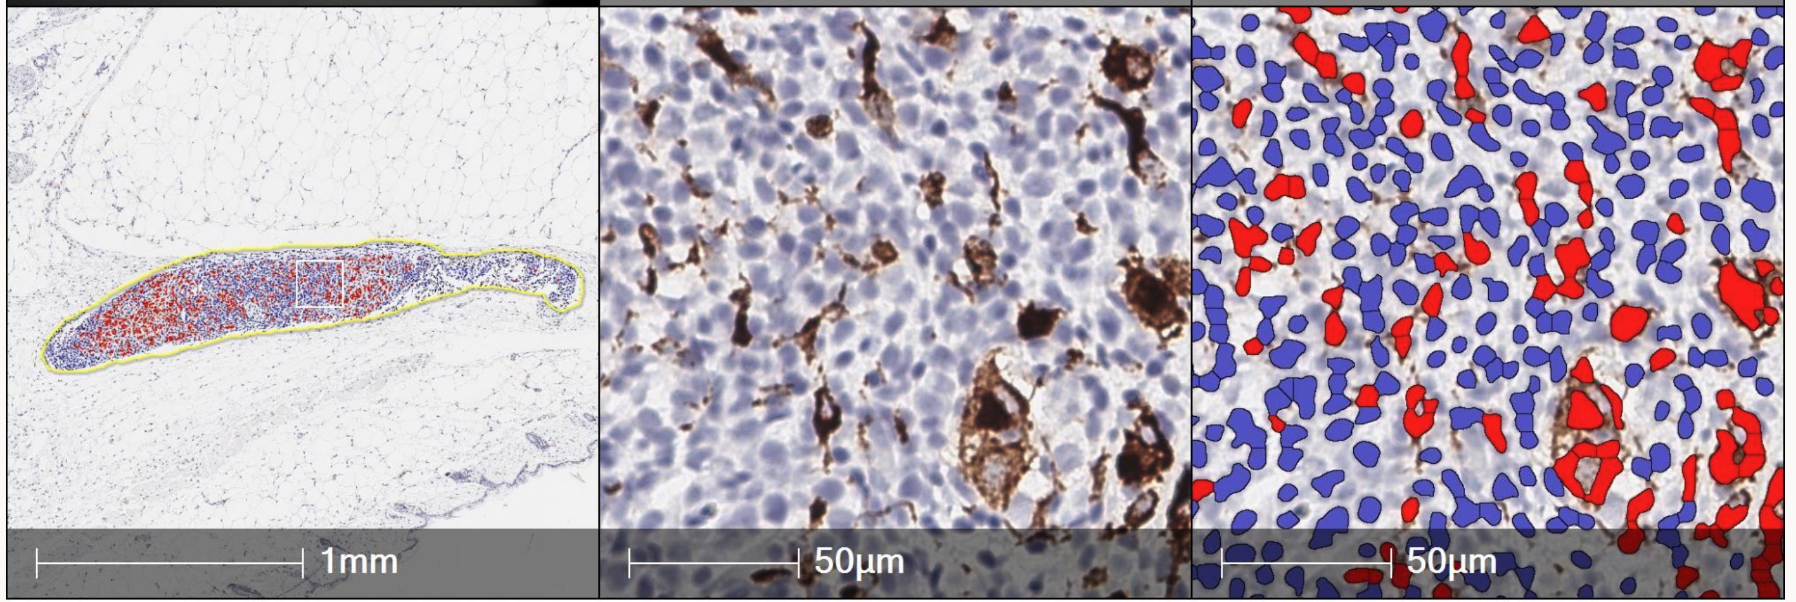
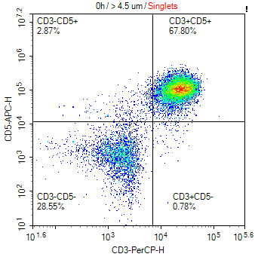
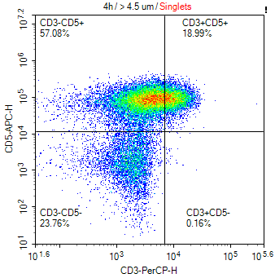
In vivo generation of tumor-metabolism-regulated HER-2-specific CAR+ cells eradicate established HER2+ gastric carcinomas with
the novel subcutaneous route of administration of CD3-directed lentivector-loaded lymphocytes
Frederic Vigant, Anirban Kundu, Dongming Zhang, Junyi Zhang, Lintao Liu, Gregory Schreiber, Ewa Jaruga-Killeen, Michelle Andraza, Renata Soares, Jonathan Kato, Cody Gowan, Michael Betts, Alan Ponce, Ramya Yarlagadda, Suraj Kachgal, Gregory Wade, Wei Zhang, Gregory I. Frost, & Sid P. Kerkar
EXUMA Biotech Corp., 625 N. Flagler St., Suite 625, West Palm Beach, FL 33401
Key Messages
Subcutaneous (SC) injection of peripheral blood total nucleated cells incubated for 4h with CD3-directed lentivector (LV) generates novel Tumor-Metabolism-Regulated (TMR) HER-2-specific CAR+ cells capable of enhanced proliferation and anti-tumor immunity
CD3-directed lentivectors are capable of triggering CD3 internalization and NFAT-based T cell activation following 4-hr of exposure to PBMC
Following SC administration, tertiary lymphoid structures comprised of T cells, macrophages, and dendritic cells foster the generation of CAR+ cells at the site of injection
Abstract
Results
Introduction: Chimeric antigen receptor therapies (CAR-T) are highly effective and durable treatments for hematologic malignancies. Nevertheless, many challenges exist to these products, including the delayed time to treatment due to manufacturing complexities, and the potential for on-target off-tumor toxicities. Here, we provide data from a pre-clinical model of established HER-2 expressing gastric carcinomas treated with a rapidly manufactured autologous cell therapy administered with the novel subcutaneous approach utilizing lymphocytes loaded with a CD3-directed vector encoding a tumor-metabolism-regulated (TMR) HER-2 CAR.
Methods: TMR HER-2 CAR constructs were generated as previously reported. Here, we developed a lentivector(LV) expressing a TMR HER-2 CAR, a novel transgene encoding an intracellular signaling motif (synthetic driver) optimized for CAR+ cell proliferation, persistence, and cytotoxicity, and CD3-directed LV envelope which activates the lymphocytes, permitting both transduction and an initial proliferation signal. An NFAT-reporter assay was utilized to determine the direct induction of CD3-driven T cell activation by the CD3-directed lentivector. Flow cytometry was utilized to determine the time course kinetics of CD3 internalization. To visualize the cellular location of LV following 4-hr exposure, an ultrastructural analysis was performed through transmission electron microscopy (TEM). For in vivo studies, total nucleated cells from freshly isolated peripheral blood were exposed to TMR HER-2 LV for four hours, washed, formulated, and injected subcutaneously (SC) into NCI-N87 tumor-bearing B-NDG mice. A longitudinal interrogation of circulating CAR cells (persistence) was conducted with a PCR-based assay of peripheral blood and tumor measurements were conducted daily as a marker of efficacy via CAR-mediated anti-tumor immunity. Digital quantification of immune cells obtained from excision of tissue at the site of SC injection was conducted in a PBMC humanized mouse model to characterize the in vivo time course maturation of injected cells.
Results: In vitro bioassays of CD3 redirected LV demonstrated a dose-dependent response in NFAT reporter luminescence activity. This direct LV activation of T cell signaling was concordant with measurements of CD3 internalization that occurred in a time-dependent manner during the 4-hour exposure to LV as measured by flow cytometry. Through ultrastructural TEM analysis, following 4-hr exposure, the lentiviral vectors completed successful attachment, fusion, and internalization into lymphocytes. Following SC injection of total nucleated cells with TMR-HER2 LV loaded lymphocytes into NCI-N87 gastric cancer-bearing mice, transgene positive cells were monitored in peripheral blood supporting the robust expansion of TMR-HER2 CAR+ cells and systemic exposure accompanied by complete regression of established tumors. Histologic evaluation and digital image analysis at the site of SC injection in a humanized mouse model revealed tertiary lymphoid structures with 83% (3335/4024) of the cells present in the TLS CD3+ and 29% (1075/3703) CD68+.
Conclusion: CD3-directed LVs encoding a novel driver and TMR HER-2 CAR loaded onto PBMC are capable of T cell-specific attachment, fusion, and endocytosis following 4 hours of exposure. This interaction results in the transient internalization of the CD3 and the subsequent activation of T cells. The LV CD3-directed T cell stimulation provides initial stimulation of T cells at the site of injection with the formation of tertiary lymphoid structures and the subsequent formation and expansion of TMR HER-2 CAR+ cells. The in vivo generated TMR HER-2 CAR+ cells are capable of robust systemic expansion and elimination of established NCI-N87 gastric carcinomas.
Figure 1. CD3 T cell activation NFAT Reporter Assay
Figure 3: TCR Internalization and Ultrastructural TEM analysis of PBMC after 4-hr exposure to Lentiviral Vector at 4ºC or 37ºC
Figure 5: Antitumor immunity and CAR+ cell expansion following SC injection of peripheral-blood TNCs with lymphocytes loaded with TMR-HER2 CAR lentivector
A
B
A
B
A
B
4ºC
37ºC
CD8
TCR-αβ
Fig 3: Flow cytometry was utilized to assess the internalization of TCRαβ in CD8+ T cells following 4-hr exposure of PBMC to CD3-directed LVs at 4ºC and 37ºC. Successful TCRαβ internalization occurred at 37ºC but not at 4ºC. Transmission electron microscopy (TEM) shows an extracellular lentiviral vector particle after 4-hr exposure of PBMCs with LV at 4ºC. The PBMC samples were embedded in Spurr's epoxy resin. Thin sections of the test samples were cut, mounted on copper grids, stained with methanolic uranyl acetate and Reynold's lead citrate, and examined by TEM. Two hundred cells were evaluated for the presence of any type of particle with virus-like morphology.
Fig 5: A. B-NDG mice bearing well-established NCI-N87 gastric cancers were treated with an SC injection of total nucleated cells with TMR-HER2 lentivector-loaded lymphocytes. The lentivector(LV) expresses a TMR HER-2 CAR and a novel transgene encoding an intracellular signaling motif (NFAT-driven synthetic driver) optimized for CAR+ cell proliferation, persistence, and cytotoxicity, and CD3-directed LV envelope which activates the lymphocytes, permitting both transduction and an initial proliferation signal. The SC injection of 1M (1e6) and 5M (5e6) cells resulted in complete regression of tumors. B A longitudinal interrogation of circulating CAR+ cells (persistence) was conducted with a PCR-based assay of peripheral blood. Transgene-positive cells were monitored in peripheral blood revealing the robust expansion of TMR-HER2 CAR+ cells and systemic exposure that accompanied complete regression of established tumors.
C
D
Figure 4: Histologic and digital analysis of cells from the site of SC injection
A
Conclusions
These studies support a novel subcutaneous approach to adoptive cellular therapy that warrants clinical investigation.
In conclusion:
A subcutaneous injection of TMR-regulated HER-2 CAR lentivector-loaded lymphocytes leads to the in vivo generation of CAR+ cells that exhibit robust proliferation and anti-tumor immunity against HER-2+ N87 gastric carcinomas.
This rapid manufacturing method represents a cost-effective and scalable approach for the in vivo generation of CAR T and/or NK cells.
Within 4-hrs of exposure in PBMC or TNCs, CD3-directed lentivectors are capable of lymphocyte-specific fusion/internalization and the triggering of T cell activation, leading to the formation of tertiary lymphoid structures and subsequently CAR+ cells in vivo.
Should clinical studies confirm that TMR-regulated HER-2 CAR can indeed be consistently manufactured, released, and safely administered to patients and achieve clinically meaningful responses with acceptable CRS and ICANs burden, this would represent a significant advancement for adoptive cellular therapies.
Fig 1: A. A T Cell activation Bioassay is utilized to detect luminescence induced by receptor-mediated signaling via activation of the nuclear factor of activated T-cells (NFAT) pathway. Bioluminescence due to NFAT reporter activity was measured after approximately 3 hours incubation (Promega) B. Increasing concentrations of the Anti-CD3 antibody UCHT-1 and C. the CD3 directed LV demonstrate a dose-dependent increase in T cell activation compared with D. a non CD3-directed LV, which does not exhibit a dose-dependent relationship for T cell activation as expected.
Rapid Manufacturing of LV Loaded Lymphocytes for Subcutaneous Administration
B
CD3
CD68
Traditional CAR-T
Rapid Manufactured CAR-T
Figure 2. Time course for CD3 Internalization
Cell
Expansion
C
References
 | CD3 | CD68
Total Cells | 4027 | 3763
Positive Cells | 3335 | 1075
Negative Cells | 692 | 2688
% Positive Cells | 82.8 | 28.6
Kochenderfer et al. J Clin Oncol. 2015 Feb 20;33(6):540-9. doi:10.1200/JCO.2014.56.2025
Orentas R et al. Blood. 2013 Feb 14; 121(7): 1165–1174
Hinrichs CS et al. Blood. 2011 Jan 20;117(3):808-14
Gattinoni L et al. Nat Rev Cancer. 2012 Oct; 12(10): 671–684.
Young RM et al. Cancer Discov (2022) 12 (7): 1625–1633.
0h
4h
CD5
Schematic diagram for the rapid manufactured subcutaneous CAR platform
CD3
Fig 4: A. H&E histology and IHC for hCD3, hCD4, hCD8, hCD68, and hCD20 were performed on tissue excised from the site of SC injection in a PBMC humanized mouse model to characterize the in vivo time course of the maturation and proliferation of injected cells. Well-formed tertiary lymphoid structures comprising of CD3+, CD4+, CD8+ T cells, and CD68+ macrophages and dendritic cells were noted on D3, D7, and D14 after injection. B. Digital quantification of immune cells within the TLS structure was performed using Halo image analysis software and revealed that 83% (3335/4024) of the cells present in the TLS were CD3 positive and 29% (1075/3703) of the cells were CD68 positive.
Acknowledgements
Total nucleated cells from peripheral blood or apheresis are loaded with CAR lentivector for 4 hrs. and washed prior
to SC injection
The novel lentivector envelope binds to CD3, resulting in CD3 internalization, T cell activation, and LV internalization
Cell product consists of Total Nucleated Cells or PBMC with lentivector-loaded lymphocytes
Fig 2: Flow cytometry was utilized to determine the time course of CD3 internalization post-exposure to CD3-directed LVs. PBMC from 3 donors were exposed to LV for 4-hrs. Flow cytometry analysis for CD5 and CD3 was performed prior to LV exposure (0h) and at the 1h, 2h, 3h, and 4h time-points post-LV exposure. A representative flow cytometry plot shows an example of CD3 internalization following 4hr LV exposure with evidence of a time-dependent increase in CD3 internalization during the 4h of LV exposure.
We thank HistoWiz for tissue and histology support. We also thank Florida Atlantic University, Jackson Laboratories, and Crown Bio for in vivo support. We also thank all our colleagues at EXUMA Biotech for their helpful comments and suggestions.

