Slide 1

PowerPoint Poster slideshow with audio
Have you ever considered presenting your poster as a slideshow? You likely already use PowerPoint to build your poster or present your data in lab meetings.
If the conference you are attending allows, a slideshow is a great way to present your data in a digital-friendly format. Simply make each section of the poster its own slide.
Then, you can also record yourself using your presentation software to talk about your slides and time it to go along with a slideshow.

Slide 2
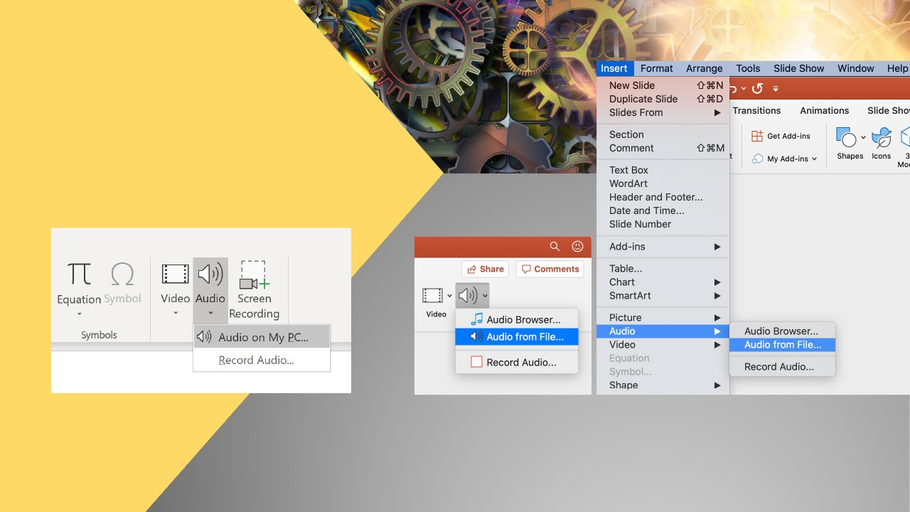
PowerPoint audio recording
Insert > Audio (PC)
Insert > Audio (mac)
If you want to add audio files to your slides, they can easily be inserted into your presentation. In PowerPoint, select “Insert > Audio from file...” and set the controls of this as you would for other animation elements on your slide.

Slide 3
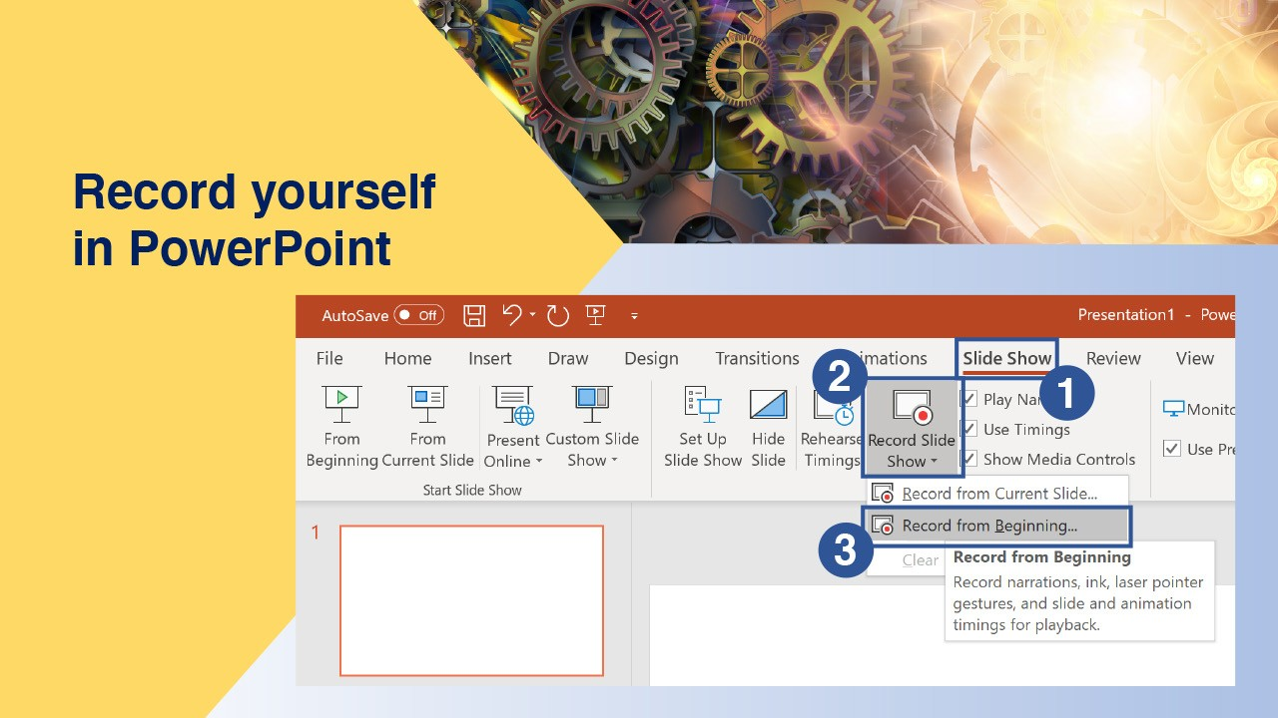
PowerPoint audio recording
Record yourself as you review your slides in real-time.

Slide 4
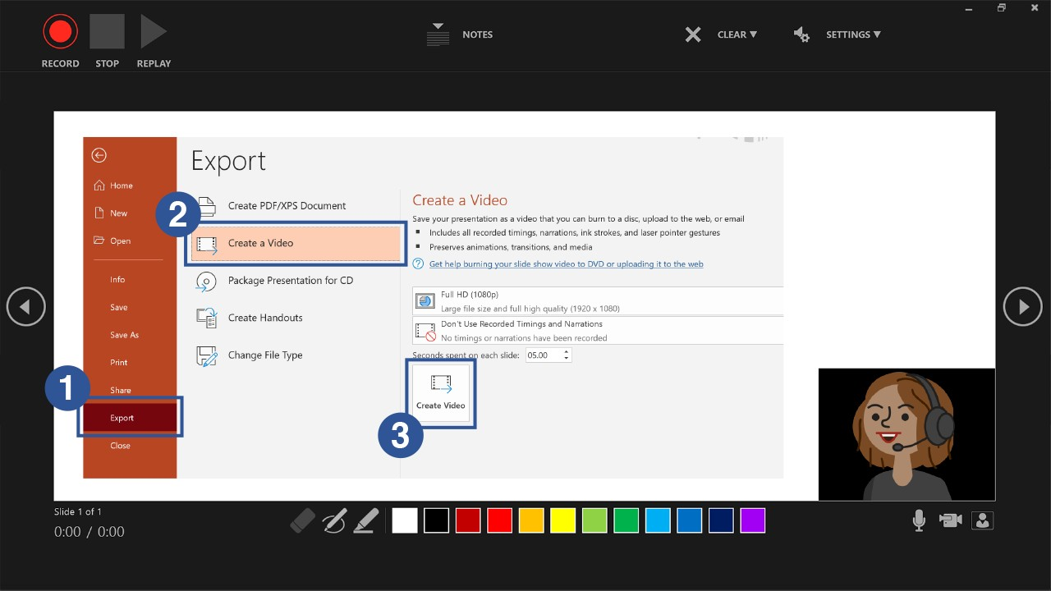
After you save your work, you can export the show to a video file.
Click here to see Microsoft’s recommened export process.

Slide 5
SUMMARY
To recap, use PowerPoint to add audio to a slide. If you have audio and animations
timed to go along with your slideshow, you can turn it into a shareable video file.
This will give you an opportunity to share more about your research when you can’t be there in person.
Use PowerPoint to add a recording to a slide
Turn your PowerPoint with audio into a video file

