Slide 1

Writing Tips

Slide 2
Writing Tip #1
When your poster is digital, it’s even more important that your writing speaks for itself because the audience won’t have you to answer questions or guide them through what you’ve written.
Before writing, figure out who you’re trying to reach and why you’re communicating with them. That will help you determine what information needs to be included—and what can be left out.
Think about who you’re trying to reach.

Slide 3
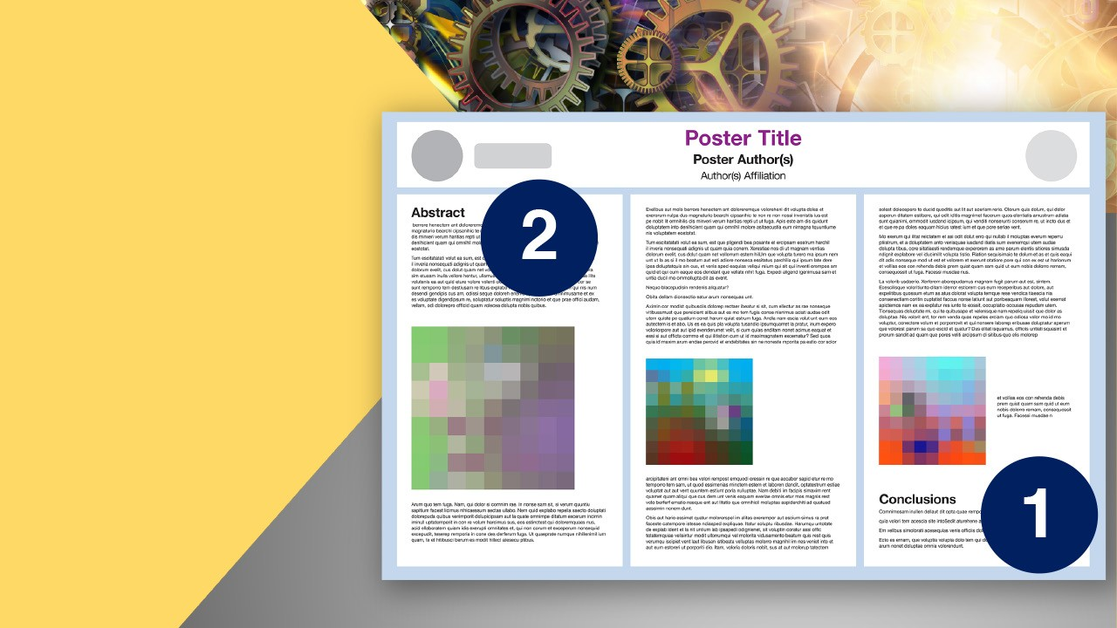
Writing Tip #2
Leading with the conclusion can hook your audience.
Many people read the conclusions of a poster first and only continue if the material piques their interest, so starting your writing there is a no-brainer. This will also provide you with direction for your poster.
The abstract is the next natural starting point for a poster presentation. It should describe, briefly and in broad strokes, what the poster is about and lead the audience into your topic.
Include details about the goal of your study but save most of the information for the figures and rest of the poster.

Slide 4
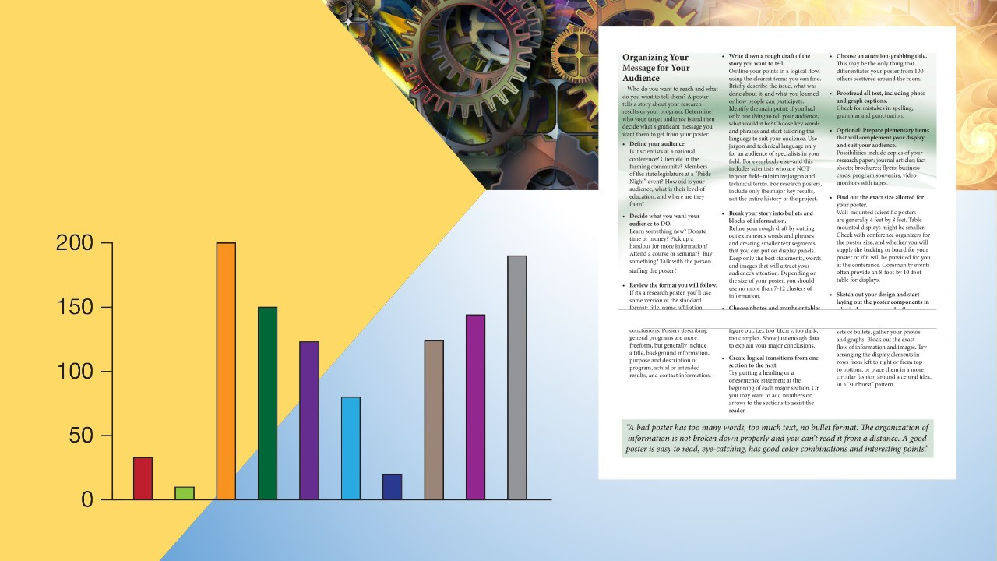
Writing Tip #3
Unlike a published manuscript, posters should rely on flow diagrams, illustrations, figures, and tables to present procedures and results. Your audience isn’t going to stick around long enough to read big blocks of text. This is especially true for digital posters.
Use visuals to aid your text.

Slide 5

Writing Tip #4
Include contact information.
You may be worried that because you’re not able to share your poster in person, your audience may miss out on valuable information. People who are interested can always get in touch with you if they want to learn more, so include your contact information, perhaps with a QR code, so others can easily follow up with you about your research.

Slide 6

Writing Tip #5
Edit your content.
Editing is Essental Essential
Rewriting is the essence of good writing. People who struggle to understand you will quickly move on. You should review your text and refine it several times if possible. Make sure it’s clear and concise, and don’t forget spelling, grammar, and punctuation. If you have time, set your work aside for a day or two so that you can review it with “fresh” eyes.

Slide 7
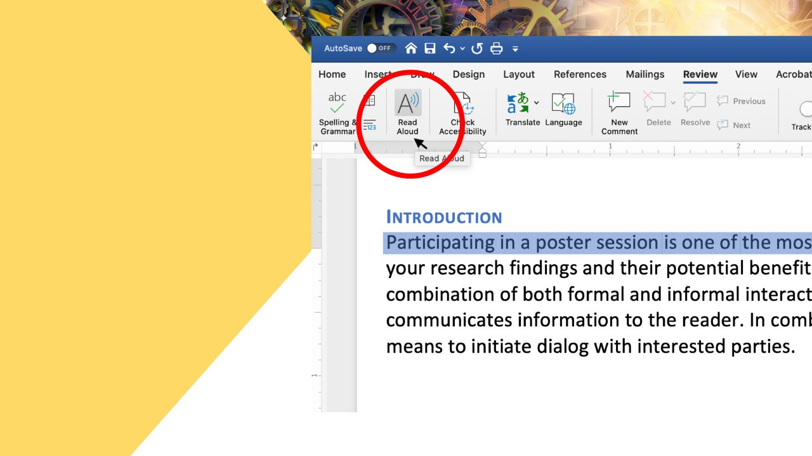
Use Read Aloud to read your text.
Another trick is to read the work aloud or use the Read Aloud feature in Microsoft Word to read the text for you. This will make it easier to catch errors, confusing sections, or run-on sentences. If you stumble over anything as you’re reading out loud, chances are it needs some revision.

Slide 8

Make sure your point is clear
Remember that your content should support your main point. Editing for clarity will help your audience get the most important information as efficiently as possible.
Remove parts that are irrelevant or repetitive. While you’re at
it, cut out or change overused words, unnecessary adverbs and adjectives, and jargon that can be simplified to make your text easier to read.

Slide 9
SUMMARY
To recap, remember to consider your audience; include the
most important information and summarize where appropriate; use supporting illustrations, figures, and graphics; edit your text; and add your contact information.
Clear writing means your audience isn’t distracted by errors and can focus on the information you’re presenting.
Consider your audience
Include only important information
Use illustrations to aid your text
Avoid common pitfalls
Edit your work
Include contact information

