Slide 1
NATIONAL CANCER INSTITUTE
NCIatFrederick
NCI at Frederick
IT Governance Program

Slide 2
Frederick IT Governance Orientation
NATIONAL CANCER INSTITUTE
NCIatFrederick
AGENDA
Review Agenda 5 minutes
Opening Comments 10 minutes
  Dianna Kelly (Program Manager, OSO)
What is “IT Governance”? 10 minutes
  Why are we implementing it?
  When will we start using it?
  Who and what projects will be required to use it?
NCI-F “IT Governance” Overview 10 minutes
  Process Overview
    Work Intake, Project Execution, Closure
  Definitions
  Organizational Structure
    Integrated Project Team (IPT)
    Technical Review Team (TRT)
    Frederick IT Governance Board (FITGB)

Slide 3
NCI-Frederick IT Governance
NATIONAL CANCER INSTITUTE
NCIatFrederick
AGENDA (cont’d)
IT Governance Website (Demo) 20 minutes
  EPLC Stages
  “Right-size” EPLC Artifacts: Small, Medium and Large Projects
  Frederick IT Governance Portfolio System (FITGPS) Link
Frederick IT Governance Portfolio System (FITGPS) – Demo 30 minutes
Closing Comments 10 minutes
  Dianna Kelly (Program Manager, OSO)
Other Questions or Feedback 25 minutes

Slide 4
Opening Comments
Goals:
  Primary goal – test the process and tools that support the process (orientation materials, web site, online workspace) to work out as many bugs as possible before rolling out the process
  Secondary goals –
    Overall training exercise
    Stakeholder buy in
Audience
  Purposely selected staff from different areas with different types of responsibilities
  IT areas
  Business and science areas

Slide 5
IT Governance Process
Opening Comments (cont’d)
Important things to remember tomorrow:
  Your input is important!!
  The process is not written in stone. We expect it to look different after the pilots
  Even at the conclusion of the pilots, we anticipate continuous process improvement

Slide 6
What is IT Governance?
Structured environment and practices for:
  decision-making
  project evaluation
  effective internal control
  ensuring the value of IT investments
Additional governance will still apply to larger projects:
  Between $1M and $10M: ITIRB, NCI Investment Board
  Between $10M and $20M: NIH
  Over $20M: HHS

Slide 7
IT Governance Benefits
Ensures available resources for projects
Ensures security involvement early in project
Enterprise view
Provides senior level review of projects through their lifecycle
Reduces duplication of effort
Compliance with FITARA, CPIC, and EPLC policies
Ensures sound IT investment decisions are made
Facilitates IT investment reporting
Improves NCIF-wide IT project prioritization
Ensures a consistent IT project management methodology
More money for science and research!

Slide 8
Timeline
Pilots:
  Pilot #1 – September 12, 13, 14
  Pilot #2 – September 26, 27
  Pilot #3 – October 11, 12
Launch:
  All new projects approved after IT Governance process launch: October 25
  “In-Flight” projects in Initiate, Concept or Planning stages:
    Begin using IT Governance process in current EPLC phase (as of October 25)
    Will not be retroactively applied to prior EPLC phases
  Future IT Services, Programs and Operations will be addressed by expansion of IT Governance process

Slide 9
What is IT Governance? (cont’d)
How will IT Governance achieve those benefits?
  Decision-making: Formal project approvals
  - Due diligence
  - Prioritization
  Project evaluation: Critical (project) success factors
  Effective internal controls: Increased adoption of EPLC framework
  - EPLC templates
  - Stage gate reviews
  Adding value: Technical Review Teams (TRTs)
  Frederick IT Governance Board (FITGB)
NEW
NEW
NEW

Slide 10

NATIONAL CANCER INSTITUTE
NCIatFrederick
IT GOVERNANCE OVERVIEW
Work Intake
Project Execution
Project Closure
Key Highlights:
Due diligence
Project approval
Project prioritization
Project Process Agreement
Project Execution:
Planning and Requirements Analysis
Design, development, testing and implementation of IT solution
Customer engagement
Project Closure:
Spending closure
Project Completion Report
Operational Assessment
Disposition (as applicable)
Process can be customized to accommodate Agile projects!
Initiation | Concept | Planning | Requirements Analysis | Design | Development | Test | Implementation
1
2
3
4
5
“Delegated” Stage Gate Reviews can be combined and additional reviews may be added!
Mandatory Stage Gate Reviews
(All Projects)
Delegated (Non-Mandatory) Stage Gate Reviews
(May be Combined or Eliminated)

Slide 11
Definitions
Additional Definitions, Acronyms and Terms, on website
Project
A temporary endeavor to complete a specific deliverable. Projects have:
  A specific start and end date
  Specific objectives
  Resources assigned to perform the Project’s work
  A Project Manager who has overall responsibility for the Project
The end is reached when:
  The project’s objectives have been achieved.
  The project is terminated because its objectives will not or cannot be met.
  The need for the project no longer exists.
Service: a set of activities organized and structured in processes and supporting procedures.
Services are performed to plan, deliver, operate, and control support to customers.
Operations: the processes and services responsible for the smooth functioning of the infrastructure and operational environments—including the network infrastructure; compute; storage; end user devices; IT service management.
Program: a group of related projects and services managed in a coordinated way.

Slide 12
Teams and Board(s)
NEW
All Projects
Integrated Project Team (IPT)
Technical Review Team (TRT)
Frederick IT Governance Board (FITGB)
Large Projects
May also include other boards, depending on project cost (e.g., ITIRB).
NEW

Slide 13
Teams and Boards
Integrated Project Team (IPT)
Staff from appropriate subject matter areas—e.g., Systems Engineering, Security, Software Engineering, Project Management, etc.
  overall project level responsibility
  a (large) project may have multiple IPTs
  engages the customer throughout project
  develops EPLC artifacts (entire lifecycle in mind)
  seeks guidance and assistance outside of the IPT as needed
  positions the project for successful outcomes in stage gate reviews

Slide 14
Teams and Boards (cont’d)
Technical Review Team (TRT)
Representation from “core” subject matter areas—e.g., Systems Engineering, Security, Software Engineering, Project Management—and other areas (e.g., business, finance, scientific, administration)—based on project needs.
  reviews EPLC artifacts and other project-related documents
  conducts non-mandatory stage gate reviews
  collaborates and supports IPT through quality assurance, independent assessment and review.
Members cannot also be on the project’s IPT.
NEW

Slide 15
Teams and Boards (cont’d)
Frederick IT Governance Board (FITGB)
Static core includes executive-level leaders from OSO, MOSB and LBR. Other members as needed—e.g., government IC, NCI DOC, MOSB, LBR, additional OSO staff.
  provides leadership to the governance process
  reviews recommendations from TRT
  conducts mandatory stage gate reviews
  recommends action
  manages the NCI at Frederick IT portfolio
  sets priorities
  - Direct Responsibility To The OSO Director And MOSB Director
  - Dotted Line Responsibility To NCI CIO
NEW

Slide 16
Projects to Which IT Governance Applies
Who or which projects must use IT Governance process?
Frederick–managed IT Projects
All projects will initiate through IT governance process
  Due Diligence
  Approval
  Initiation through Planning Stages
Additional governance will apply to larger projects:
  Less than $1M: FITGB
  Between $1M and $10M: ITIRB, NCI Investment Board
  Between $10M and $20M: NIH
  Over $20M: HHS
Applicability of artifacts and stage gate reviews will be determined during “Concept” stage.

Slide 17




Process Overview: NCI-Frederick IT Governance
Work Intake
Project Execution
Project Closure
Milestones:
Project Approved
Project Team Assigned
Milestones:
IT Solution Implemented, Tested and Released for use
Milestones:
Project Team Released
Legacy Solution(s) Retired, as applicable

Slide 18

Process Overview: Work Intake
Work Intake
Project Execution
Project Closure
Other (e.g., LBR, Out of Cycle)
Task Orders, “Yellow Tasks”
Approved Projects
Project Requests (e.g., Mandates)
Key Highlights:
Due diligence
Project approval
Project prioritization
Input Received From?
Business Units
Audit-Driven Project Needs
“Mandates”
etc.
Projects Approved By Who?
FITGB

Slide 19
Process Overview: Work Intake (cont’d)
Work Intake
Project Execution
Project Closure
Project Approval Decision
Prioritization
IPT and TRT Assigned
Key Documents
Business Needs Statement or Business Case (EPLC Artifact)
NCI CPIC/FITARA Investment Selection Coordination & Transmittal Template
NCI CPIC Evaluation Criteria Template
Project Process Agreement
EPLC Phases:
Initiation
Concept

Slide 20
Process Overview: Work Intake (cont’d)
Work Intake
Project Execution
Project Closure
Project Process Agreement
  Formally documented and agreed with Project Sponsor (or Business) early in project
  Records and justifies decisions regarding artifacts and delegated stage gate reviews
  Add or Combine artifacts or stage gate reviews?
Important
document!
“Right-Sized” EPLC Artifacts
Recommendations based on factors,
such as:
  - Estimated Project Budget
  - Estimated Project Duration
  - Estimated Project Team Size
Stage Gate Reviews
  “Delegated” Stage Gate Review:
    TRT performs reviews; decides outcome.
    Can be combined or eliminated.
  Mandatory Stage Gates Review:
  TRT performs review; recommends outcome to FITGB.

Slide 21
Process Overview: Project Execution (cont’d)
Work Intake
Project Execution
Project Closure
Project Process
Agreement
EPLC Phases
  Planning
  Requirements
  Design
  Development
  Test
  Implementation
Informs artifacts and stage gate reviews.
IT Governance Website
Frederick It Governance Portfolio System (FITGPS) Collaboration Site
Stage Gate Reviews
  Approved
  Approved with Conditions
  Not Approved
  Project can be ended at any stage

Slide 22
Process Overview: Project Closure
Work Intake
Project Execution
Project Closure
Implementation Stage (latter half)
  Project Completion Report
  Contingency Plan
  Disposition Plan
“Disposition Plan” is not applicable if project does not involve replacing an existing (i.e., “legacy”) system.

Slide 23
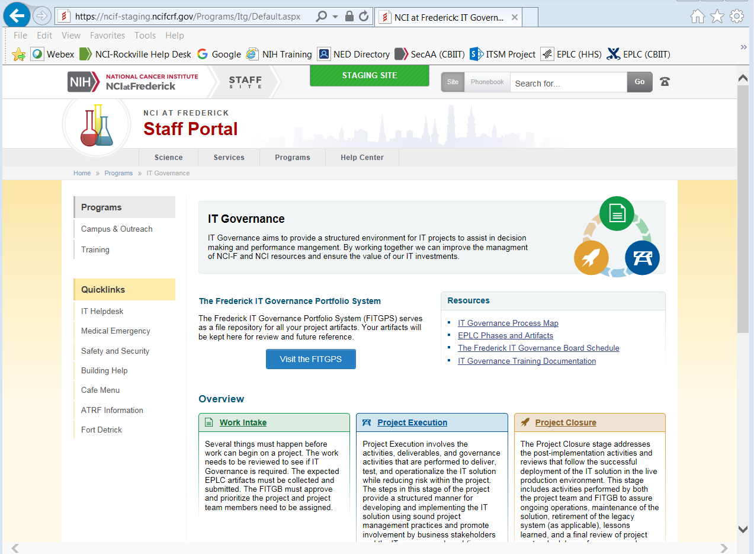
IT Governance Website

Slide 24
Highlights & Tips to Remember…
General: Use the Project Process Agreement (PPA) to identify the EPLC artifacts, stages and stage gate reviews Complete only relevant sections EPLC artifacts. Use the IT Governance website as your guide—as Frederick has streamlined EPLC stages, simplified stage gate review artifacts, etc.

Slide 25
Highlights & Tips (Cont’d)
Concept Phase: Project Management Plan (PMP) is an “umbrella” document that contains sections for many topics that can: be directly incorporated into the PMP artifact, or refer to separately completed EPLC artifacts that correspond to each PMP section. “Project Process Agreement” (PPA) and “Business Case” are required documents for all projects.

Slide 26
Highlights & Tips (Cont’d)
Concept Phase: (cont’d) “Project Size Estimation Guide” for determining project size (i.e., small, medium, large) informs EPLC artifact recommendations for artifacts and stage gate reviews. The project size category and recommendations may be changed by the TRT or FITGB during the Concept phase. Project teams should consider merging sections of the “Project Charter” with the “Business Case. “Project Process Agreement” and “Business Case” are required artifacts.

Slide 27
Highlights & Tips (Cont’d)
Implementation Phase: “Business Product” refers to the actual IT solution, and is not an artifact to be created nor to be addressed by PPA. “O&M Manual” must address ongoing security (ISCO) support. “Disposition Plan” is needed only if the IT solution being implemented replaces an existing (i.e., “legacy”) system. In such case, “Disposition Plan” should address the system being retired—not the new system. If no legacy is being retired or replaced within scope of the project, the “Disposition Plan” is not applicable.

Slide 28
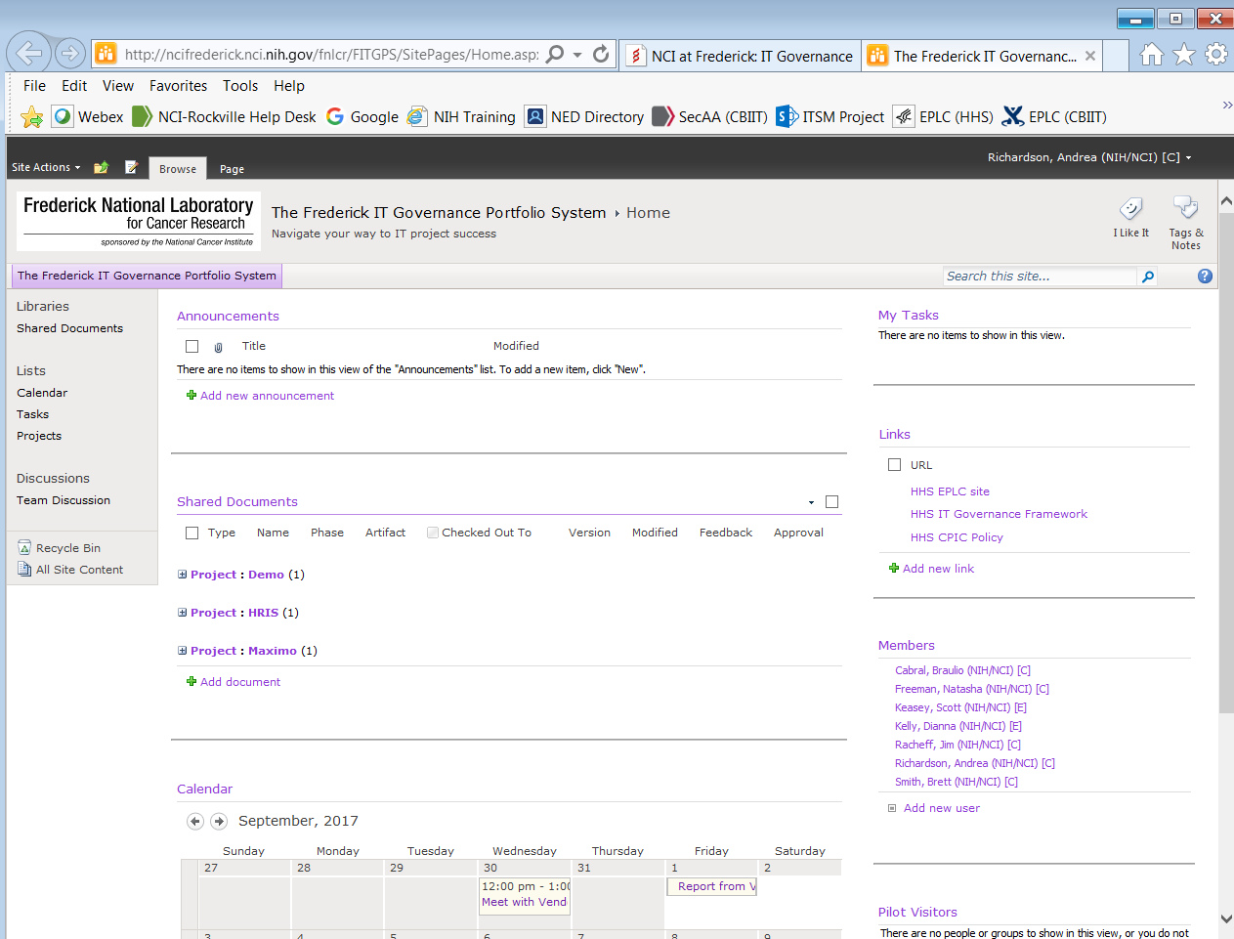
Frederick IT Governance Portfolio System (FITGPS)
Interim Portfolio Management Tool

Slide 29
Highlights & Tips to Remember…
Stage Gate Reviews: Stage Gate Review templates should not be modified. Questions or deliverables that do not apply to the project should be noted as “Not Applicable”. FITGPS Collaboration Site: Store project documentation (e.g., artifacts, assessments, reference materials, etc.) on new FITGPS collaboration site, which is organized by EPLC stage.

Slide 30
Highlights & Tips (cont’d)
FITGPS Collaboration Site: (cont’d) In general, TRT members will be the approvers for most EPLC artifacts. Additional approvers may be needed (e.g., Contingency Plan should be approved by “Disaster Recovery/Business Continuity” point of contact—usually Roxanne). Review/Approval of artifacts should occur outside of (i.e., prior to) the respective stage gate review.

Slide 31
Highlights & Tips (cont’d)
FITGPS Collaboration Site: (cont’d) When you modify an artifact that was started or completed in a prior EPLC stage, do not remove or modify the original artifact. Instead, make updates and revisions in a copy of the original artifact document and save it as a new version (e.g., v2.0 or “Final Draft”) in your current EPLC stage—rather than changing or deleting the original artifact.

Slide 32
Feedback
  Questions?
  Suggestions or Feedback?

Slide 33
Closing Comments
What to expect tomorrow:
  Where do I go?
  What do I bring?
  What’s going to happen?
Questions

Slide 34
Closing Comments
  Thank-you!

